Slide 1
Scheduling Perl Scripts
Have your workstation run Perl for you! (In Windows)
Notes:
This slideshow is for using the Windows Task Manager, for scheduling on Linux, please look up crontab documentation: https://help.ubuntu.com/community/CronHowto

Slide 2
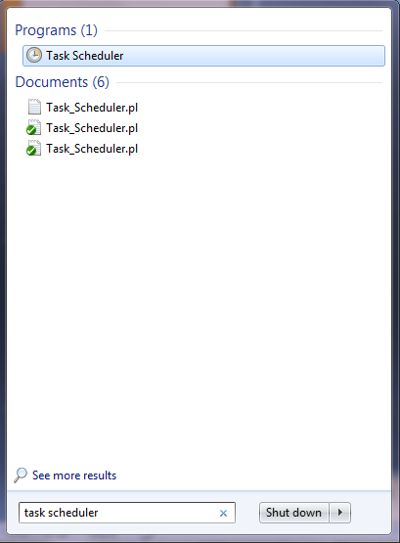
Setting up the task scheduler
Find the Task Scheduler via the start menu search bar.

Slide 3
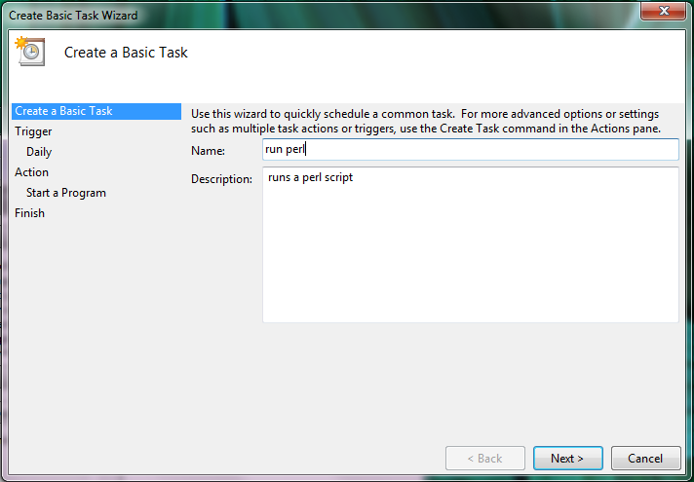
Create a Basic Task
This part is pretty self explanatory, just follow instructions until the “Action” part, then select “Start a Program”

Slide 4

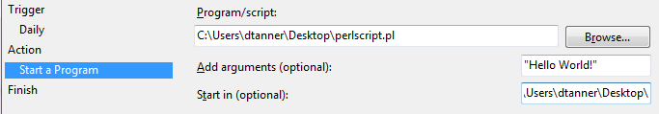
Set the time, then find the script
This perl script will open a GUI box that I can close. I’m basically making a popup for myself to prove a concept.
#!/usr/local/bin/perl
use Tk;
# Main Window
my $mw = new MainWindow;
my $label = $mw -> Label(-text=>"$ARGV[0] !!") -> pack();
my $button = $mw -> Button(-text => "Quit",
-command => sub { exit })
-> pack();
MainLoop;

Slide 5
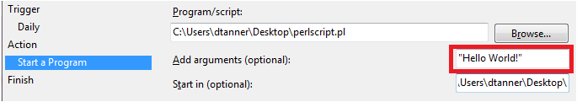
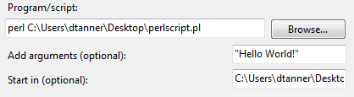
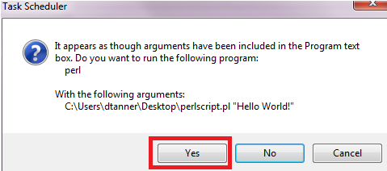

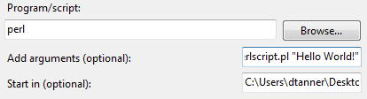
More Details
Arguments for your script can be put in here.
If you don’t have the “.pl” file extension, add “perl” to the beginning with a space. We are technically making the script an argument here, so agree to make it an argument:

Slide 6
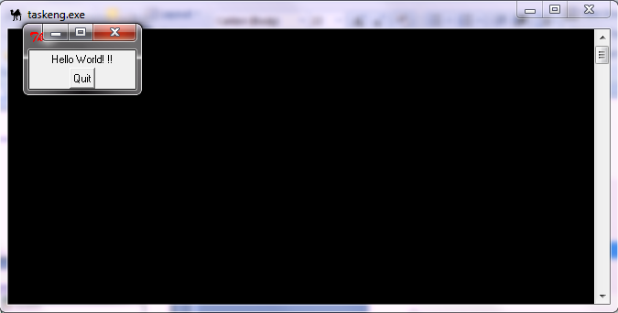
Finishing and testing
Wait for the time to come, and your script should run. “taskeng.exe” should show up if you did it correctly, and this small GUI if you used my perl script.

Slide 7
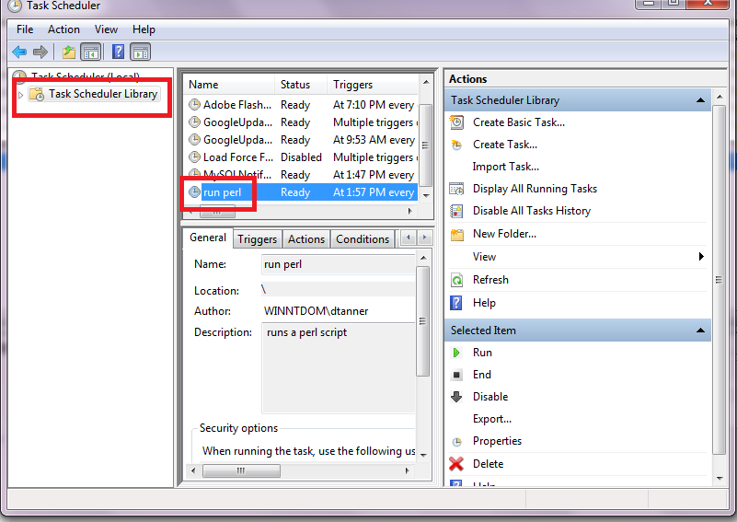
Further editing
To tweak your task further, select the Task Scheduler Library and find the name of the task you created. Everything is editable from there.

Slide 8
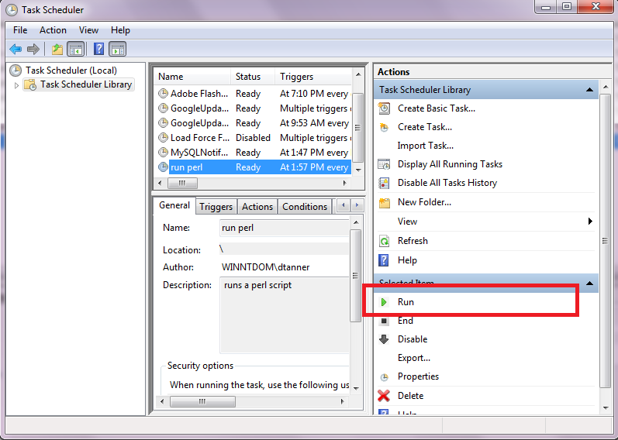
Further editing
You can also force the task to run without waiting for a time by selecting “Run”. It’s a good way to test things.

